Slide 1
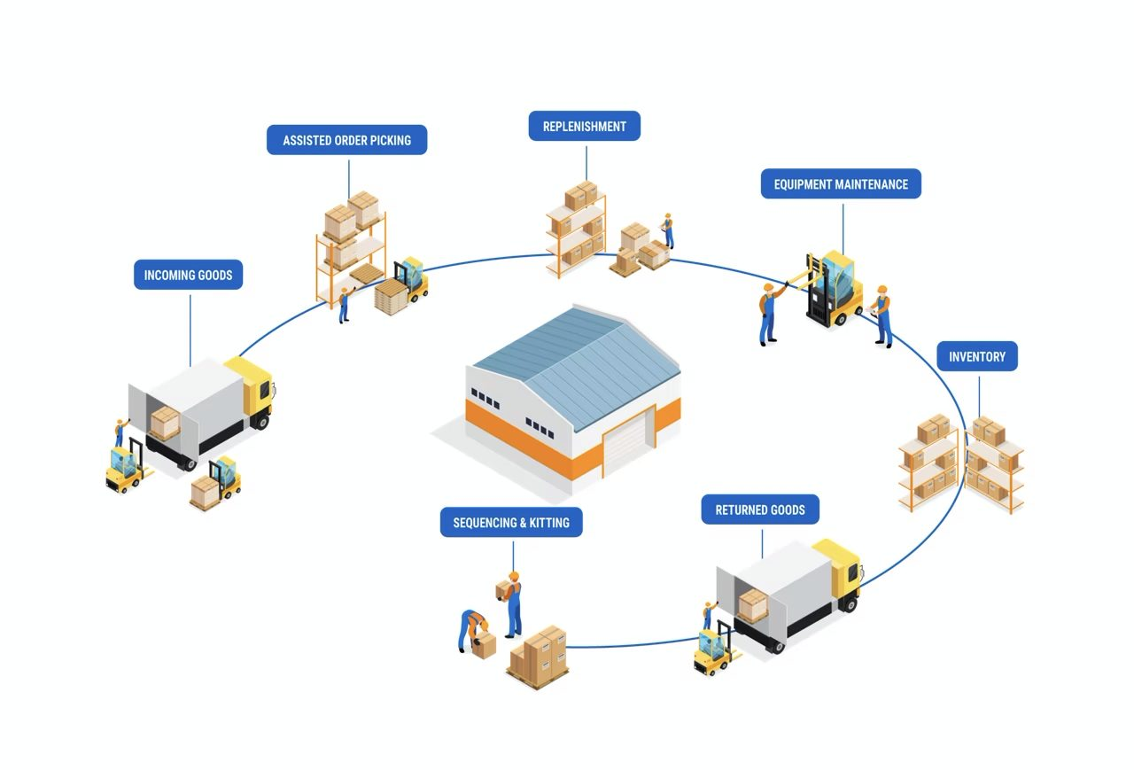
3. OVERVIEW OF SUPPLY CHAIN MANAGEMNT

Slide 2
Supply Chain Management:
The term was first used in public in an interview with Arnold Kransdorff of the Financial Times on 4 June 1982.
The term Supply Chain Management came into widespread use in the 1990s.
Supply chain Management builds upon the concept of logistic and seeks to achieve linkage and coordination between the processes of other entities in the pipeline ( suppliers and customers).

Slide 3
A supply chain is the network of all entities involved in producing and delivery finished product to the final customer.
The supply chain management includes sourcing raw materials and parts, manufacturing, producing and assembling the products, storing goods in warehouse, order and tracking, distribution and delivery to the final customer.
The supply chain stages may include; suppliers, producers, wholesaler/distributors, retailers and customers.

Slide 4
Supply chain are under increasing financial pressure and stages that do not value to the supply chain are quickly by passed or eliminated. For this reason chains are sometimes called value chain or value networks.
The stage of the supply chain that comprises the inbound direction towards the company are called upstream part of the supply chain. suppliers are upstream.
The stages of supply chain away form the firm are called downstream. Distributors, retailers and customer are downstream.

Slide 5
SCM activities include the following;
Coordination:
SCM involves coordinating the movement of goods and services through the supply chain, from suppliers to manufacturer to distributors to final customers. It also involved the movement of funds through the supply chain and products are purchased and sold.

Slide 6
2.Information sharing:
This includes sharing demand some forecasts, point-of –sales data, promotional campaigns planned inventory levels.
3. Collaboration:
SCM requires collaboration between suppliers members so that they jointly plan, operate and execute business decision as one entity.

Slide 7
Functions of supply chain Management:
Purchasing: It pertains to procuring raw materials and other resources that are required to manufacture the goods. It requires coordination with suppliers to deliver the materials without any delays.
Operations: The operation team engages in demand planning and forecasting. Before giving the raw materials purchase order, the organization has to anticipate the possible market demand and number of units it needs to produce.

Slide 8
If demand is over anticipated, then it could result in excess inventory cost, if the demand is under anticipated, the organization wouldn't be able to meet the customer demand, thereby leading to revenue loss. So operations functions plays a critical role supply chain management.
3. Resource Management: Any production consumes raw materials, technology, time and labor. However, all the processes need to be efficient and effective. This phase is taken care by resource management function team. It decides the allocation of resources in the right activity at the right time to optimize the production at reduce costs.

Slide 9
4. Information workflow:
Information sharing and distribution is what really keeps all other functions of supply chain management on track. If the information workflow and communication are poor, it could break apart the entire chain and lead to mismanagement.

Slide 10
Objectives of Supply Chain Management:
Service orientation
System orientation
Competitiveness and Efficiency
Minimizing the Time
Minimizing work in progress
Improving pipeline visibility
Improving visibility demand
Improving quality
Reduces Transportation cost
Reduces warehousing cost

Slide 11
Service Orientation:
Service is all about the value that the customer gets, which in turns depends upon his own perception about what constitutes value.
System Orientation:
System orientation is at the existence of any supply chain.
Synergy due to co-operation and coordination is the main gain of a supply chain.

Slide 12
Competitiveness and Efficiency:
For healthy sustain itself in order to be able to provide increasing value to its customer. Efficiency is important for competitiveness.
Minimizing the time:
Efficient chain management in organization reduce time for converting orders into cash.
Minimizing work in Progress:
Supply chain minimizes total work in process in supply chain.

Slide 13
Improving Pipeline Visibility:
Efficient supply chain improve the visibility of each one of the activities of the supply chain by each one of the partner.
Improving visibility demand:
Efficient supply chain improves visibility of demand by each on of the partners.
Improving Quality:
Supply chain management helps in improving the quality of operation of the organization.

Slide 14
Decision phases in supply chain Management
SCM includes all methods that convert raw materials into finished goods, it comprises the designing, planning, executing, controlling and monitoring of all activities within the supply chain.
Effective SCM has three main phases, namely:
1.Supply Chain Design/Strategy phase,
2.Supply Chain Planning phase,
3.Supply Chain Operations phase.

Slide 15
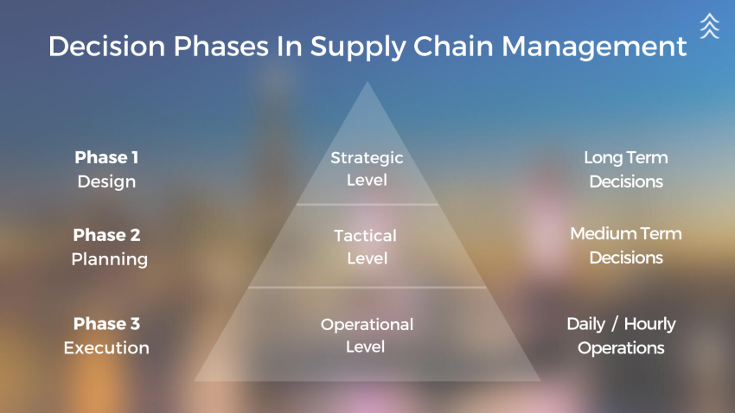

Slide 16
Supply Chain Design / Strategy phase
In the first phase, the organization decides how to define the supply chain in the years to come.
The supply chain is configured in terms of allocation of resources, the methodology of production, warehousing, and different modes of transportation. All these decisions related to the supply chain are typically made for the long term.

Slide 17
Supply Chain Planning phase
In the second phase, organizations prepare to incorporate flexibility into the supply chain in order to optimize their performance.
This phase also includes inventory decisions & allocation, in-time production, production for customized orders and the allocation of transport mode for each product.
Benchmarking of operations, strategies against market competitors and the application of best practices throughout the organization are included in this phase. Supply chain planning decisions are generally made for weeks or months.

Slide 18
Supply Chain Operations phase
The third and last decision phase comprises planning, daily or weekly production and distribution of products.
The planning of inbound & outbound operations (within & outside the organization) is done in this phase. It includes setting the delivery schedules and transportation modes with the suppliers, manufacturing units and distribution centers.

Slide 19
Process of supply chain Management:
The process in a supply chain are divided into series of cycles, each performed at the interface between two successive stages of a supply chain.
Cycle view of supply chain is useful in making operational decisions as role of each member of supply chain clearly defined.

Slide 20
Each cycle occurs at the interface between two successive stages
Customer order cycle( customer-retailer)
Replenishment cycle( retailer- distributors)
Manufacturing cycle( distributors- manufacturer)
Procurement cycle( manufacturer-suppliers)
Cycle views clearly defines processes involved and the owners of each process. Specifies the roles and responsibilities of each member and the desired outcome of each process.

Slide 21
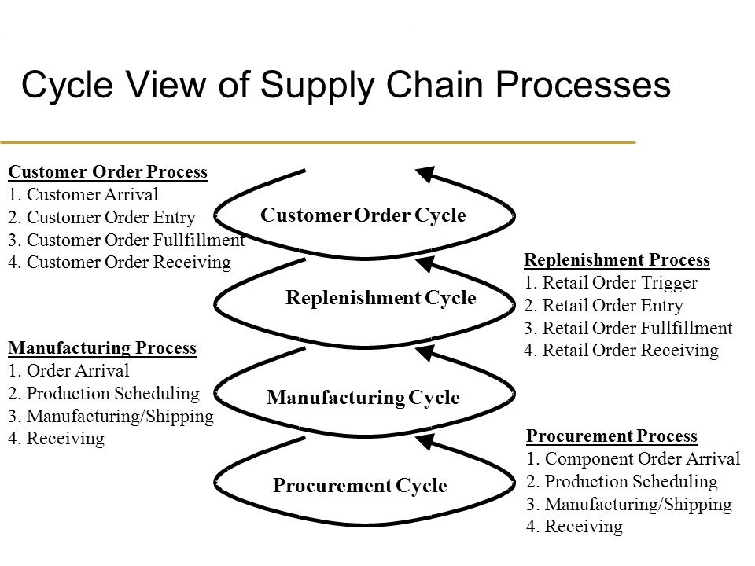

Slide 22
Push view of supply chain :
Push strategy in SCM involves producing goods based on forecasts, streamlining production schedules, and improving inventory management.
Companies using a push strategy can improve customer satisfaction by up to 20% by meeting demand promptly.
Push : Execution is initiated in anticipation of customer orders ( speculative).
Advantages of a push strategy include better inventory control, forecasting accuracy, reduced lead time, alignment of supply and demand, and focus on standard products.

Slide 23
Pull view of supply chain:
Pull: execution is initiated in response to a customer order ( reactive)
Pull strategy in SCM involves producing goods based on actual customer demand, reducing excess inventory, and enhancing flexibility.
Companies embracing the pull strategy can cut inventory costs by up to 50%, according to a study.

Slide 24
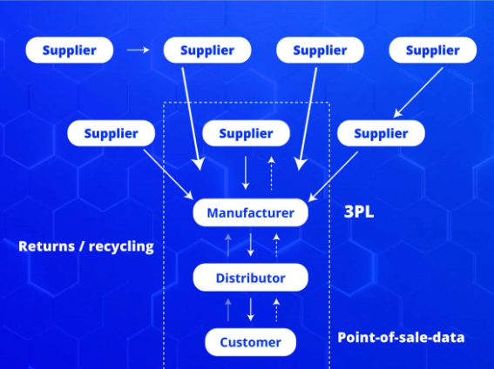

Slide 25
Difference between push and pull supply chain:
1.In push strategy production is triggered( release) based on forecasts of future demand. Where as production is triggered by actual customer orders.
2.Products are pushed through the supply chain to intermediaries i.e. distributors, retailers and end customers, even if they have not yet been ordered where as production are pulled through the supply chain only when they are needed.
3. Push strategies are often used for products with predictable demand and a long shelf life where as pull strategies are often used for products with unpredictable demand or a short shelf life.

Slide 26
Flow management in supply chain:
Supply chain is a critical element in understanding business operations. SCM is the oversight of finances, materials and information when the movement happens from suppliers to manufacturer, wholesalers and retailers and at last reach to customer via defined procedures.
Supply Chain Management Flow chart: Product flow, information flow and finance flow are the three main flow associated with supply chain management.

Slide 27
Product Flow: The movement of goods from the suppliers to the consumer and returns and other service requirements.
Information Flow: Transferring orders and updating the state of delivery.
Finance Flow: Incorporates payments schedules, consignment, credit terms, and also title deed arrangements.

Slide 28
Importance of supply chain management:
Control of supply and demand
Sourcing and raw materials
Manufacture and assembling products
Inventory tracking
Order management
Distribution through multiple channels
Delivery of service or products

Slide 29
Pitfalls and Opportunities in supply chain:
The problem or mistakes in the plan which increase the chance of failing plans are called pitfall in planning.
No supply chain metrics
Inadequate definition of customer service
Inaccurate delivery status data
Inefficient information system
Ignoring the impact of uncertainties
Discrimination against internal customers
Poor coordination

Slide 30

All the best for the new dawn

Slide 31

Thanks

